Slide 1
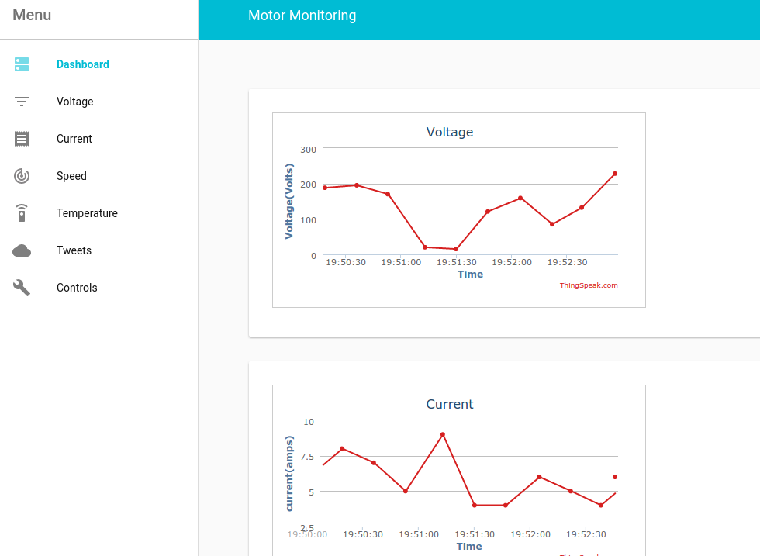
REMOTE MONITORING OF INDUCTION MOTOR
Done By,
J.U.PAVITHRAN,
M.P.SAKTHIVEL,
R.ARANGANATHAN
Guided By,
Prof.Kandasamy

Slide 2
INTRODUCTION
Nowadays with the emergence of Internet of Things(IOT),the Monitoring and controlling of machines have become much simpler and can be manipulated from any part of the world
The proposed idea will focus on monitoring of induction motor through a Web App powered by NodeJS as backend and using Arduino.

Slide 3
OBJECTIVE
Monitoring the induction motor remotely, facilitates the user to have full control over the application where the motor is put to use.
so the idea will be greatly useful in Industrial Automation and Home automation applications which uses induction motor as the actuator.

Slide 4
OBJECTIVE
The existing monitoring solutions are offline and doesn't provide control over HTTP protocol so the application is limited to small distance only.
Also this monitoring system uses NodeJS as backend ,so the whole web can be manipulated Eg:- posting updates to Twitter,facebook,alerts to mobile phone through Twilio API...etc,
Also the application is cross-platform that can be used in android,ios,windows or any other platform.

Slide 5
METHODOLOGY
Embedded Hardware- Arduino UNO.
Sensors used -Current sensor(ACS712),speed sensor,Temperature sensor(LM35).
Web-Hosting- www.000webhost.com
NodeJS middle-end for posting status updates to twitter
Thingspeak API for pushing data to cloud from arduino.
Google Polymer for designing the cross-platform web app.

Slide 6
Block Diagram
R
CT
SPEED
PT
Y
IM MOTOR
B
LM35
LCD
ARDUINO UNO
ESP8266
P.S.

Slide 7
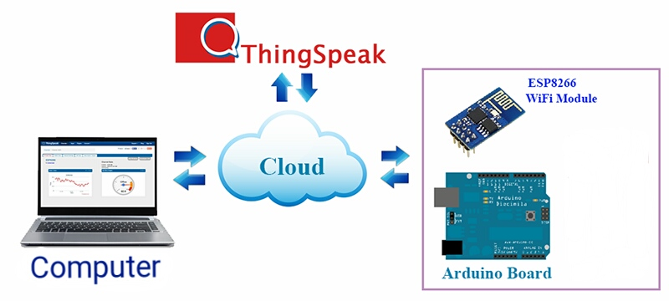
sensors

Slide 8
PARAMETERS MONITORED
Temperature of motor.
Speed of motor.
Load Current .
Load Voltage .

Slide 9
PROPOSED WORK
Dec - 18 Project protype.
Jan - 6 review 2
Jan - 22 Demo 1
Feb - 9 Demo 2

Slide 10
REFERENCES
http://www.intorobotics.com/build-robot-without-arduino-shield-r3-dc-stepper-motors-controlled
https://www.openhomeautomation.net/internet-of-things-dashboard
https://www.arduino.cc

